Slide 1
Total Productive Maintenance
A Team Effort to Improve Overall Equipment Effectivity

Slide 2

Other Modules In This Series:
5S
Standard Work
Total Productive Maintenance (TPM)
Administrative Lean
Cell Design/ Production Preparation Process (3P)
Kaizen
Kanban
Problem Solving
Poka Yoke Quality Systems
Transaction Process Improvement (TPI)
Cause & Effect Diagram with the Additions of Cards (CEDAC)
Single Minute Exchange of Dies (SMED)
Value Stream Mapping (VSMi®)
Visual Management
Managing Daily Process Excellence
For More Information Please Contact:
Mark DeLuzio, President and CEO
+1.860.234.0915
mark.deluzio@leanhorizons.com
Strategically Creating Value Through the Elimination of Waste

Slide 3
This document contains confidential
and proprietary information owned
by Lean Horizons Consulting, LLC.
Any disclosure, use, copying or
distribution of this information without the express written consent of Lean Horizons Consulting is strictly prohibited.

Slide 4
Ground Rules for Event
Safety first (use personal protective equipment)
Active participation by all
Start and end on time
All electronic gadgets (phones, pagers, etc) turned to “off” or “silent”
Computers to be used only when instructed
Keep an open mind to change
Don’t let “perfect” get in the way of “better”
Notes:
DO: Perform Group Introductions. Pick an ice-breaker or exercise to warm the team up to the event. (Icebreaker Example: Everyone uses their name tent and writes a “Personal License Plate” in which they have 2 minutes to creatively use a total of 7 letters or numbers to tell us something about themselves. Examples “LV2SAIL” OR “DADOV5”
DO: Review Event Ground Rules.
ASK: “Does anyone have any rules they would like to see added?”
ASK: “Does everyone agree to these?”

Slide 5
What is TPM?
It is an approach to maximize the effectivity of the plant’s equipment in the areas of uptime, speed, and quality
It is an approach that utilizes the experience and talent of the operator, the maintenance technician, and engineering as a team
It goes beyond simply restoring and repairing the equipment. It includes sustaining processes and continuous improvement
It improves the efficiency of those people involved in the setup, operation and maintenance of the equipment
TPM is NOT “Totally Painted Machines” but rather
“Taking Pride in our Machines”
Notes:
SAY: “TPM brings CI to the maintenance of equipment and ties the equipment into the Lean program directives.”

Slide 6
Exercise: Discussion
Objective
Discuss past equipment maintenance experiences.
Instructions
Time to Complete
In small groups, discuss and answer:
“What are some of the problems we face in maintaining equipment?”
Select one person to record answers.
10 minutes
Deliverable
One participant from each group reports answers discussed to class
Notes:
SAY: To change the mindset from what we always have done, to what we ought to be doing, or what we could be doing. This is a way to help maintenance people think about how their jobs will be changing in the lean environment. This issue of change in their jobs is a serious issue. You have to have some vehicle for enabling folks to try on the new role and see what it would be like. Visioning helps with that.
( 10 minutes) Everyone thinks silently, jotting down ideas about what would make the best situation for this specific machine
Example: no walking around machine, only using one wrench instead of 4 different ones, etc.
( 10 minutes) Invite folks to share ideas with whole group, don’t force them to share, facilitator writes on chart paper
Keep this collection of ideas up in the room during the work. Use it to remind people of the ways that things will change whenever folks get tied up in knots over some idea that challenges the way we do things now.
Examples of ideas which might be generated:
Less reactive
Collect more equipment data
Spend more time on machine improvements
Focus on improving speed of repairs
More predictive maintenance
More time to document what happened & why
Increased focus on root cause analysis in problem solving
Well organized flow of work and materials
Upfront evaluation of maintenance issues during pre-install
Develop methods to error proof maintenance work
Less random tasks, more planning
Maintenance & machine operator partnerships
More skills training for operators
More pre-inspection & pre-analysis
Standardized maintenance protocol
Move away from returning equipment back to baseline, and toward optimizing equipment

Slide 7
Goal Of Total Productive Maintenance
Apply the TPM Process on targeted equipment to improve uptime, speed and quality as well as implement a process to sustain and continuously improve the results.
Loss Data
Analysis and
OEE
Restore
Deterioration
Autonomous
Maintenance
OEE
Sustain and
Improve
Maintainability
Improvement
and
Maintenance
Avoidance
Notes:
SAY: “So why are we here? What do we want to accomplish?”
DO: Cover points on the slide.

Slide 8




Who uses TPM?
Company Results
A $5MM investment resulted in a $16MM increase in profits which could be traced to TPM implementation
Began in 1992 – led to improvements in productivity and costs
Started in 1986 – productivity increase of 50-80%
Improvements in maintenance costs, lead times, and OTD
Started in 1991 – increased capacity, cost reductions
$200MM/year savings attributable to TPM
Established “Maintenance Excellence Recognition Award”

Slide 9
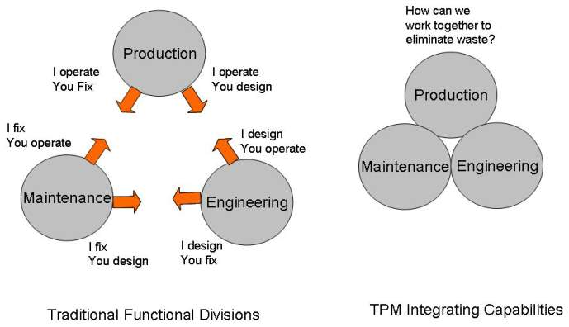
Traditional vs. TPM
Notes:
DO: Discuss the behaviors associated with the traditional model. (Thinking very functionally, this is someone else’s job or responsibility… etc.)
SAY: “Each department has unique knowledge and experience for each piece of equipment. TPM will combine the strengths into a systematic Continuous Improvement maintenance program.”

Slide 10
Why Implement TPM?
Improve Customer Service
Improve Quality
Improve Cost
Improve Environmental, Health, and Safety
IMPROVE PROFITABILITY!
Notes:
ASK: “How does TPM improve each of these elements?”

Slide 11
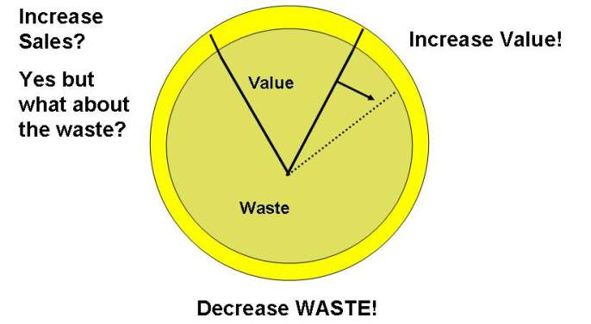
Can We Respond to the Challenge?
Notes:
SAY: “The product that maintenance offers is capacity. The more the equipment is up and running efficiently, the more product can be made.”
SAY: “Opening capacity will result in unneeded additional asset purchases and resources to run the equipment.”

Slide 12
TPM should be tied to VSM Kaizen Bursts
Mike’s Metal Enclosures (MME)
30/60/90
Forecast
Weekly
Fax
Production Control
Demand = 30,000 Enclosures/month
1 Shift
Acme
Sheet Metal Co.
Monthly P.O.
(Faxed)
Daily Orders
(EDI)
Ed’s Electrical Supply
MRP
System
Takt Time
27,000 Seconds
1,500 Pieces
= 18 seconds
1X
Week
Weekly Build
Schedule
(Paper)
Weekly Build
Schedule
(Paper)
Weekly Build
Schedule
Paper
Daily Ship
Schedule
(Paper)
Daily
Cut
Stamp
Brake Form
Ship
I
I
I
Improve
DOI
I
= 5
= 1
= 1
3,200 Sheets
Reduce
Manpower
5,250 Pieces
9,300 Pieces
2,300 Enclosures
1 sheet yields 4 pieces
DOI = 12”
C/O Time = 30’
Uptime = 99%
Quality = 99%
5 Machines
DOI = 15”
C/O Time = 30’
Uptime = 99%
Quality = 98%
DOI = 20”
C/O Time = 120’
Uptime = 80%
Quality = 99%
1 pc Flow
TPM
8.5 days
3.5 days
6.2 days
1.5 days
Production L.T. = 19.7 days
Processing Time = 275 seconds
240 sec
15 sec
20 sec
Notes:
SAY: “We don’t just want to make changes - anything done in a focused event has to be of value to the company. To make certain we produce the best results we will use a tried and true method :
PDCA = Plan, Do, Check, Act
Events should be tied to Future State Value Stream Map “Kaizen Bursts”
Where does this event fit into the map? What results should we achieve?”

Slide 13
The TPM Process
Analyze data to understand historical performance
Corrective Maintenance, stabilize equipment condition and restore deterioration
Autonomous Maintenance, effectively utilize operators to act as the eyes and ears of the mechanics
Install a process to sustain and improve Overall Equipment Effectivity
Improve maintainability of equipment
Reduce the need for maintenance
Notes:
SAY: “The TPM process will allow you to capture meaningful and useful data to establish a baseline.
PDCA cycle will be used to drive improved results, using data and “scientific” methods to eliminate root causes of downtime.”

Slide 14
The “Big Three”
If you have not changed
  Operating Procedure
  Maintenance Procedure
  Equipment Design
You are doomed to repeat history!
Notes:
SAY: “TPM will lead to new procedures and checks for operators. Maintenance will have a new focus of solving the problem versus just a quick fix to get it running again until another breakdown. This will lead to countermeasures and modifications to equipment for permanent solutions.”

Slide 15
Exercise: TPM Charter Review
Objective
Review the TPM Charter for the event against charter criteria
Instructions
Time to Complete
As a team review the event charter and answer the following questions:
What is the business need for this event?
What are the pre-selected departments?
What are the event boundaries?
Who is the owner?
What are the goals for this event?
30 minutes
Deliverable
Make any modifications
to charter as necessary.
Notes:
SAY: This is why we are here.
Example: We will find ways to reduce unplanned downtime by 50% and yield losses by 50%. To do this we have to analyze maintenance data to determine the root causes of our downtime and our yield losses. What can we do to increase the capacity of the plant? What can we do to reduce the losses from defects caused by poorly operating equipment? Insert details for your company and departments. Describe the project they will be assigned in very specific terms.
GO OVER THE PROJECT DEFINITION PAGE IN DETAIL.
Make sure everyone understands the scope of work and the deliverables.
EXPLAIN WHY THIS PIECE OF EQUIPMENT WAS SELECTED – Is it critical to the process? Is it pivotal for the next stages of improvement?
DO: Specifically describe on which areas or departments we are focused here today.
DO: Set the boundaries - where each “process” starts and where it ends.
REDUCE UNPLANNED DOWNTIME BY 50% - only want equipment to be down when we have a planned maintenance event, or no work.
REDUCE YIELD LOSSES BY 50% - reduce losses due to equipment problems.
FIND ROOT CAUSE OF DOWNTIME - get to root cause of what causes equipment failures, how often is it happening?
FIND ROOT CAUSE OF REDUCED PERFORMANCE – of the equipment, why isn’t it running at top speed?
INCREASE RELIABILITY – of the equipment, need predictability.
INCREASE EFFECTIVENESS – of the equipment – that it does everything it is supposed to do, and does those operations well.
IMPROVE MAINTENANCE RESPONSE TIMES – caution: this one could upset people if you don’t frame it right. The point isn’t that maintenance isn’t responsive, or customer service oriented. They are. But they also have to set priorities and they cannot get to everything at once. So how long does it take before maintenance can respond to a problem on a critical piece of equipment? Is that an acceptable amount of time? Why isn’t the response time shorter? Because they have other fires to fight. Can we eliminate as many of the smaller fires as possible so that maintenance can respond quickly to the critical pieces of equipment? Sure we can, if we systematically implement TPM throughout the plant.
◆ You want your group to have the project in mind while they hear everything else in today’s session. It all needs to tie to these objectives. In fact, any time during the session, if they get off track, you can bring them back into focus by showing this slide again. This is what we are going to do. Any conversations that aren’t about this work need to be tabled and issues recorded in the parking lot.
◆ The goal is set at a reasonable 50% improvement!! No one actually knows if this is attainable, but try anyway. Maybe you can do better than that. If we make an improvement at all, We Win! And in the process of trying, we are likely to learn things that will lead to improvements later. We have been selected to do this because we are the people invested in this process and who have the expertise in this area. Some of us are here just to help give another perspective. We are going to work together to get this done. Collaboration!!

Slide 16
Loss Data Analysis and Overall Equipment Effectiveness
Loss Data Analysis and OEE
Restore
Deterioration
Autonomous
Maintenance
Sustain and
Improve
OEE
Maintainability
Improvement &
Maint. Avoidance
Objectives:
Define equipment effectiveness
Identify the Six Big Losses
Complete an analysis of historical performance
Identify components of OEE
Calculate OEE
Notes:
DO: Review section objectives on slide.

Slide 17
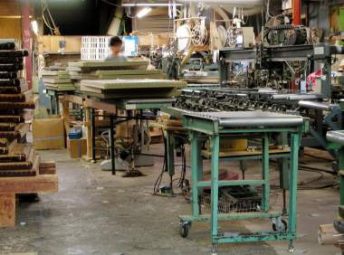
What is Maintenance’s Product?
Loss Data Analysis and OEE
Equipment Effectiveness
More equipment availability
More robust quality output
Reduced interruptions longer time between failures (MTBF)
Responsiveness to customer demands
Safety
The goal is collaboration among maintenance, engineering and operations so more time can be spent on those activities which add value
Notes:
SAY: “Maintenance doesn’t produce a revenue generating product! Instead what they provide the plant is capacity so that more of the revenue generating products can be made! Capacity is the product of the maintenance group.”
Capacity =
More equipment availability – uptime
Longer time between failures (unplanned downtime, catastrophic failures, etc.)
MTBF = mean time between failures (how long between failure events)
Better quality products – less defects caused by equipment problems, does the fact that the tumble blast is running a little
slower than normal mean that the parts aren’t getting as clean so there is more scale on them and more grinding has to be done? Are you running the parts longer to make up for the poor performance of the equipment?
Responsiveness to customer demands – what if we need to be able to do something with the equipment that we cannot do now? Is maintenance available to work on this improvement project?
The goal is to have maintenance mechanics spend more time on those TPM activities (like predictive & preventative maintenance) which increase plant capacity. Less time on fighting fires and re-repairing nuisance breakdowns.

Slide 18
Goal: To reduce losses
Loss Data Analysis and OEE
Loss Categories Six Big Losses
Downtime
Breakdowns
Setup and adjustment
1
Speed Losses
Idling, minor stoppages
Reduce speed
2
Quality Losses
Startup and yield
Defects and rework
3
Notes:
SAY:
“Downtime is not only breakdowns. TPM metrics will measure setup and adjustment downtime also. We talked about TPM being part of the Lean program, and driving down machine setup and adjustment is part of it.
Operators will reduce the speed of machines because it “runs better”. This could be true, but using problem solving tools, 5 why’s and the PDCA loop, speed losses can be eliminated.
Defects, rework, and yield can be a big factor on downtime. Building a pile of bad parts because of machine problems could be the cause. Using problem solving tools to fix this will improve quality.”

Slide 19
Analysis of Historical Performance That Is It?
Loss Data Analysis and OEE
A process by which you review the past performance of a particular machine in three areas using objective quantifiable data
  Machine related Uptime
    Easy
  Quality output
    Harder
  Speed output
    Hardest!
Notes:
SAY: “The data collection is the key to TPM improvement. Often, data is lacking on the kickoff of TPM. Establishing how, who, when, etc, on the data collection needs to be addressed up front. Methods to start collecting the Machine, Quality, and Speed data needs to be established first. Just like all Lean activities, let the data point to the focus of improvement. Without a standard (data), achieving any improvement is difficult.”

Slide 20
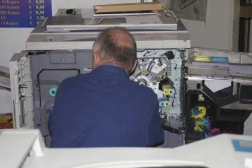
Analysis of Historical Performance:
Why do you do it?
Loss Data Analysis and OEE
PM programs typically only look at equipment down time
  Often even this is not measured in an accurate and rigorous manner
  PM plans are rarely modified
  Improving equipment effectiveness is a scientific process
Notes:
SAY: “The PDCA process is consistently used in the TPM program. Focusing where the data is pointing will give you the biggest bang for the buck.”

Slide 21
Analysis of Historical Performance:
How do you do it?
Loss Data Analysis and OEE
    Gather Production, Quality, and Downtime data
Pareto each failure
Complete “Loss Data Analysis” chart
Use problem solving tools for highest occurrences

Slide 22
Analysis of Historical Performance:
How do you do it?
Loss Data Analysis and OEE
    Gather Production, Quality, and Downtime data
Pareto each failure
Complete “Loss Data Analysis” chart
Use problem solving tools for highest occurrences

Slide 23
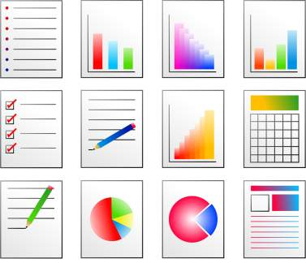
Analysis of Historical Performance:
How do you do it?
Loss Data Analysis and OEE
Gather Production, Quality, and Downtime reports from the previous three months (or more) of operation

Slide 24
Analysis of Historical Performance:
How do you do it?
Loss Data Analysis and OEE
For speed losses, interview operators and observe the process for subtle interruptions that are so short as to go unnoticed
  Use high-speed video playback if you can
  Conduct root cause analysis and corrective action
For quality losses identify each defective product generated at the work center and identify those that potentially have any contribution from equipment capability
  Conduct root cause analysis and corrective action
For Downtime losses identify the subsystem involved
  Conduct root cause analysis and corrective action
Notes:
SAY: “Ensure a standard is established on data collection.”
SAY: “Establish standards work for the Operator, Maintenance and Engineering on data collection, submission, and analyzing. Review forms and practices. There could be a problem in the details.”

Slide 25
Analysis of Historical Performance:
How do you do it?
Loss Data Analysis and OEE
    Gather Production, Quality, and Downtime data
Pareto each failure
Complete “Loss Data Analysis” chart
Use problem solving tools for highest occurrences

Slide 26
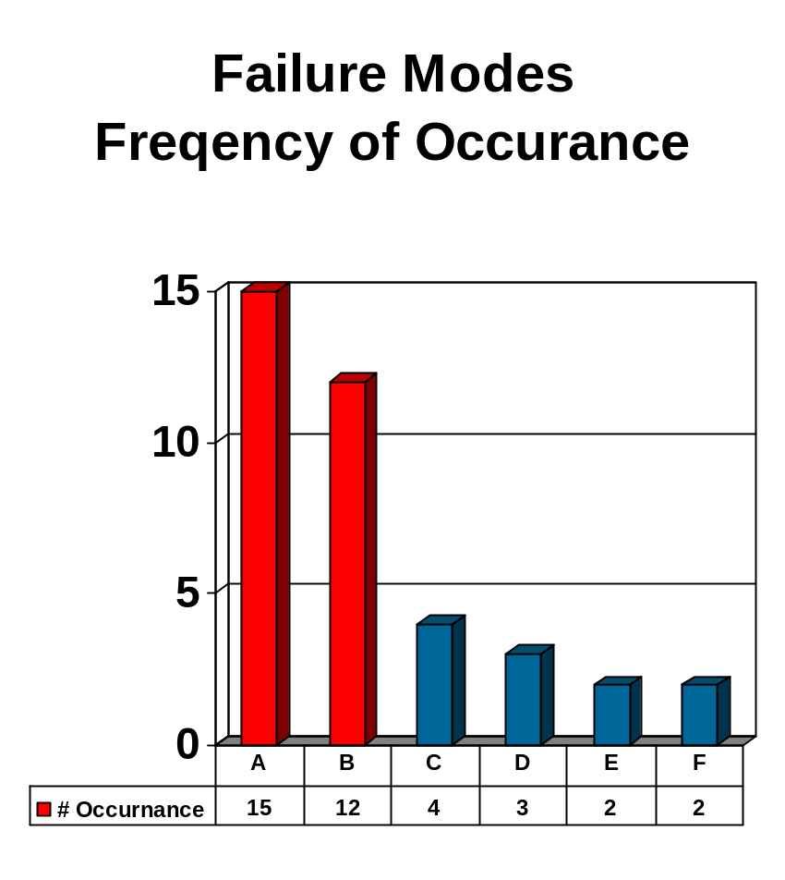
Pareto Analysis
Loss Data Analysis and OEE
The majority of the impact generally comes from the minority of the problems. The “80-20 rule:”
Problem “A”…
Problem “B”…
Problem “C”…
Problem “D”…
Problem “E”…
Problem “F”…
Failure Modes
Frequency of Occurrence
Notes:
SAY: “Stay focused on the major problems. Go an inch wide and a mile deep, versus a mile wide and an inch deep. Attacking the top 2-3 problems could eliminate most of the downtime.”

Slide 27
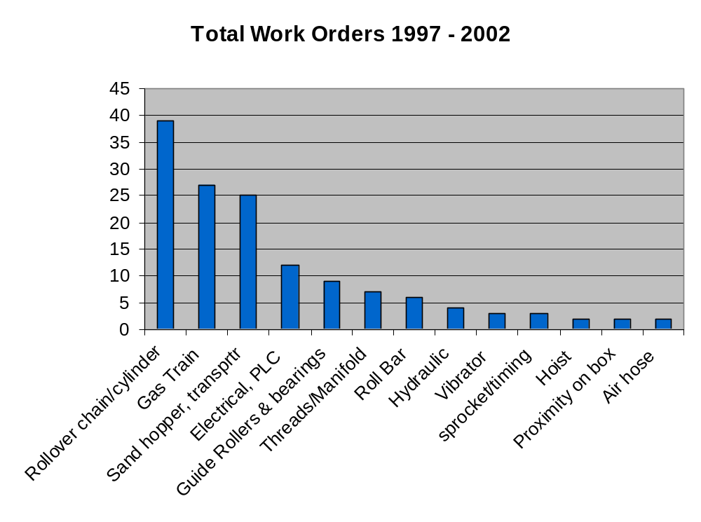
Maintenance Work Order History Example: Mold Machine
Loss Data Analysis and OEE
How many total failures?
Which modes represent 80% of the occurrences?
Notes:
NOTE: This slide is here ONLY to illustrate what maintenance data looks like when plotted. You will want to refer to your own data here.

Slide 28
Analysis of Historical Performance:
How do you do it?
Loss Data Analysis and OEE
    Gather Production, Quality, and Downtime data
Pareto each failure
Complete “Loss Data Analysis” chart
Use problem solving tools for highest occurrences

Slide 29
Loss Data Analysis
Loss Data Analysis and OEE
 |  |  | Loss Data Analysis Chart
Failure Description & Frequency |  | Type of Loss |  | Root Cause |  | Modify |  | Comments
 | Down Time | Speed | Quality |  | Maint | Operation | Design
Notes:
SAY: “Very important to interact with the operators on this. Operators spend more time on the machines than with their families. They know the machines and can detect a problem by the way is sounds and feels. They also know the reasons why they need to slow the machines down, often being the only person(s) that knows this information.”

Slide 30
Evaluate Quality Data
Loss Data Analysis and OEE
What defects are caused by the equipment?
Can these be reduced?
Find the root cause
Be sure data is accurate and useful
Find improvements that will increase output of good parts
Reduce dependency on special skills if possible
Notes:
SAY: “Take any quality data you collected before the event and examine it to see what you learn about the equipment performance and effectiveness. If the equipment is causing defects, then improvements have to be made to eliminate this negative effect immediately.”
SAY: “Ask the 5 Why’s on the cause of the defects. Use the PDCA cycle on implemented improvements, ensure the fixes are truly fixed.”

Slide 31
Analysis of Historical Performance:
How do you do it?
Loss Data Analysis and OEE
    Gather Production, Quality, and Downtime data
Pareto each failure
Complete “Loss Data Analysis” chart
Use problem solving tools for highest occurrences

Slide 32
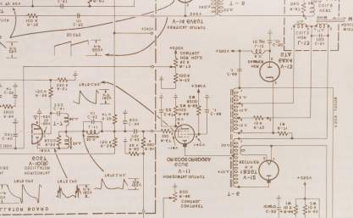
Analysis of Historical Performance:
How do you do it?
Loss Data Analysis and OEE
Starting with the highest occurrence, use readily available means such as 5 whys analysis, fish bone diagrams, drawings & schematics
If root cause is still not determined, use more sophisticated problem solving techniques outlined in Six Sigma

Slide 33
Exercise: Analysis of Historical Performance
Loss Data Analysis and OEE
Objective
Analyze the historical performance of the equipment.
Instructions
Time to Complete
Follow the process outlined on the previous slides to analyze the performance of the target equipment.
Answer: What failure modes represent 80% of the occurrences in the target equipment?
Provided by instructor
Deliverable
Report out on the top failure modes of the target equipment.

Slide 34
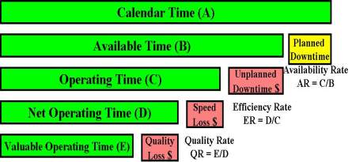
Calculating Overall Equipment Effectiveness
Loss Data Analysis and OEE
Overall Equipment Effectiveness
World Class Targets
OEE = AR * ER * QR = E/B
Availability Rate = 90%
Efficiency Rate = 95%
Quality Rate = 99%
OEE = 89%
Target Opportunities = $
Notes:
NOTE: OEE deals in time and time can be directly correlated to money.
The chart explains how the OEE calculation is made and also clearly shows the opportunities for improvement in red.
The organization has strategic goals, focus and OEE as the key indicator.
Now they need the tools to attack the target opportunities and make improvements.

Slide 35
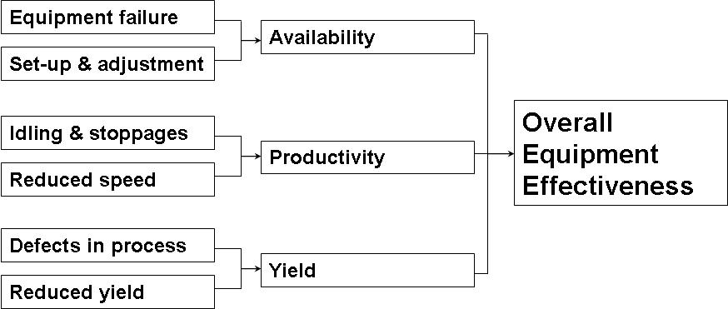
Calculating Overall Equipment Effectiveness
OEE = Productivity * Availability * Yield
Notes:
SAY: “OEE will not only expose equipment failure, but problems with setup, speed and wait time, and quality defects caused by the equipment.”

Slide 36
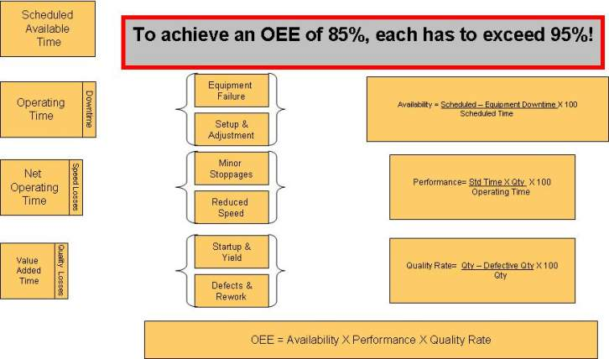
Calculating Overall Equipment Effectiveness

Slide 37
Exercise: Calculate OEE
Loss Data Analysis and OEE
Objective
Calculate the OEE for an example.
Instructions
Time to Complete
Use the information provided on the following slide to calculate OEE.
10 minutes
Deliverable
Brainstorm silently, jotting down ideas.

Slide 38
Exercise: Calculate OEE
Loss Data Analysis and OEE
An OEE observation was conducted for an entire workday
Two shifts of 8 hours each
Lunch period of 30 minutes during which equipment is shut down
Two (10) minute breaks, allowed for fatigue and personal needs, equipment is kept running utilizing Team leader to relieve operators
There was one die change which required 10 minutes, and one downtime incident which required 15 minutes to repair
The press cycle time is 45 seconds
457 parts were made on the first shift
451 parts on the second shift
There were 26 rejected parts in the two-shift period
What’s the Machine’s OEE??

Slide 39
OEE Example – The Answer!
Loss Data Analysis and OEE
Scheduled time = (7.5 Hrs x 2 Shifts) = 900 minutes
Availability = = 97.2%
Performance = = 77.8%
Quality Rate = = 97.1%
OEE = 97.2% x 77.8% x 97.1% = 73.4%
900 Min. - 25 min.
900 Min.
.75 Min. X (457+451 Pcs.)
875 Min.
(457+451 Pcs.) - (26 Pcs. Rejected)
(457+451 Pcs.)

Slide 40
Exercise: Calculate OEE
Loss Data Analysis and OEE
Objective
Calculate the OEE for the equipment for this event.
Instructions
Time to Complete
Use the calculation provided on the previous pages with the data for this event to calculate OEE.
20 minutes
Deliverable
Calculated OEE.

Slide 41
Restore Deterioration
Loss Data Analysis and OEE
Restore
Deterioration
Autonomous
Maintenance
Sustain and
Improve
OEE
Maintainability
Improvement &
Maint. Avoidance
Objectives:
Define “Restore Deterioration” process and identify importance
Identify how to “Clean to Inspect” the equipment
Discuss the Red Tag procedure
Identify how to “Inspect to Correct” components of the equipment
Implement “Clean to Inspect” and “Inspect to Correct” for target equipment
Notes:
DO: Review section objectives on slide.

Slide 42
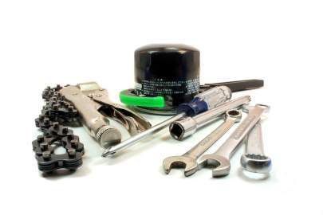
Restore Deterioration: What Is It?
Restore Deterioration
A concentrated effort to repair all known defects in the equipment and return it to “as new” operating condition
A method of catching up on minor non-conformances that have built up over time
Some day, later, when we have time….. TODAY!!!!!!!
Notes:
SAY: “Get equipment to “as new” condition for the purpose of sustaining it at this level.”

Slide 43
Restore Deterioration: Why Do You Do It?
Restore Deterioration
Over years of operation relatively minor equipment malfunctions are accepted as the norm
The system compensates for the minor discrepancies and tends to hide the waste associated with the equipment not being up to spec

Slide 44
Restore Deterioration: How Do You Do It?
Restore Deterioration
    Clean to inspect
Inspect to correct

Slide 45
“Clean to Inspect”
Restore Deterioration
All Kaizen begins and ends with 5S. TPM is no exception!
Limit access to the “Speedy Dry, “pigs,” or other oil-absorbent material
  “Clean to Inspect”
    Cleaning the equipment leads to an in-depth inspection of components
    A comprehensive list of equipment defects is compiled using the
    “Red Tag” process
    Document ALL defects including leaks, missing screws, loose covers, sticky/missing proximity switches, door latches, all defects both minor and major
Notes:
SAY: “A dirty machine makes it impossible to see a leak, worn part, or a visual indication a repair is needed. Clean machines allow for visual inspections and action before machine failure. Identifying and repairing an oil leak can prevent downtime or catastrophic machine damage.”

Slide 46
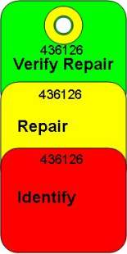
The Red Tag Process
Restore Deterioration
During the “Clean to Inspect” process each defect is identified with a red tag
  Keeps things from “falling between the cracks”
  Prevents overlooking what could become major problems later on
  Provides a metric on progress over time
Typically expect to identify at least 25 items
Red Tag List
#436118 XXXX
#436119 XXXX
#436120 XXXX
#436121 XXXX
#436122 XXXX
#436123 XXXX
#436124 XXXX
#436125 XXXX
Notes:
SAY: “The red tag process is good conduit for operators to communicate problems or issues to Maintenance. This is their work order to have something fixed.”

Slide 47
Restore Deterioration: How Do You Do It?
Restore Deterioration
    Clean to inspect
Inspect to correct

Slide 48
“Inspect to Correct”
Restore Deterioration
“Inspect to Correct”
  Red Tag items are repaired
  Uncover Drains
    Assures proper lubricant flow
    Detects air and hydraulic fluid leaks
    Detects wear and damaged parts (abnormalities)
  Cleaning is Inspecting
It is easier (less labor intensive) to maintain equipment than it is to catch up with cascading failures in operation.
Notes:
SAY: “Visual inspections by operators will sustain clean machines and warn of any problems before failure. Operators being the eyes and ears.”

Slide 49
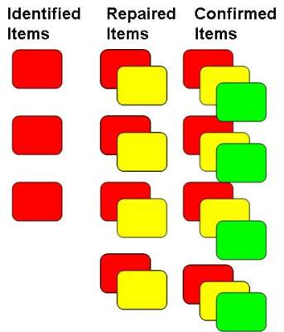
The Red Tag Process
Restore Deterioration
Number and attach tag to item in need of repair
Post Red Tag on board
When item is repaired, rip off yellow tag and post on board with date
Four weeks later verify that repair was root cause
Remove green tag and post on board for one month
Notes:
SAY: “The red tag process needs to be organized and visual. Checks and balances need to be in place to ensure the disposition of the red tag.”

Slide 50
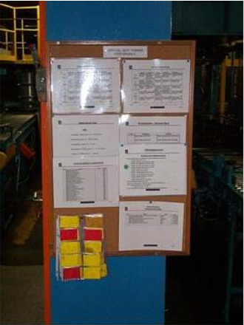
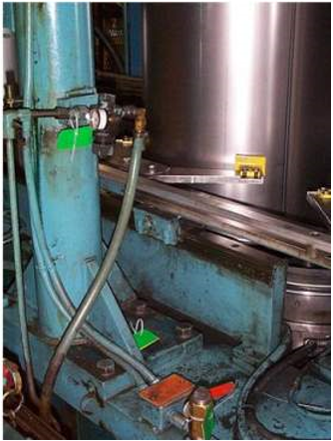
The Red Tag Process
Restore Deterioration

Slide 51
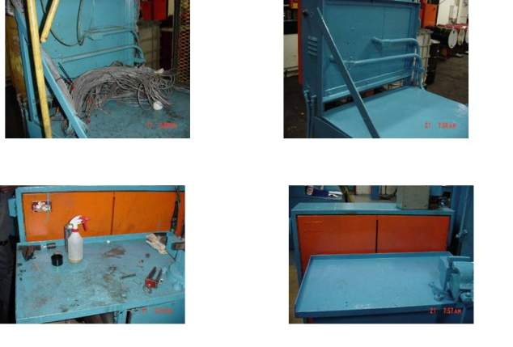
The Red Tag Process: Welder
Restore Deterioration

Slide 52
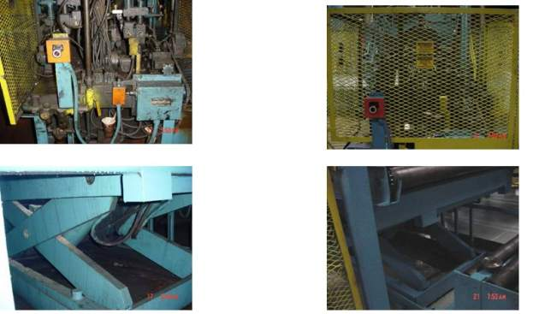
The Red Tag Process: Material Transport
Restore Deterioration

Slide 53
Exercise: Restore Deterioration
Restore Deterioration
Objective
Begin the “Clean to Inspect” and “Inspect to Correct” process for the target equipment.
Instructions
Time to Complete
Follow the process outlined on the previous slides to begin the Restore Deterioration process for the target equipment.
How many defects can you find on the target equipment?
Provided by instructor
Deliverable
Report out on Red Tag listing and status.

Slide 54
Autonomous Maintenance
Loss Data Analysis and OEE
Restore
Deterioration
Autonomous
Maintenance
Sustain and
Improve
OEE
Maintainability
Improvement &
Maint. Avoidance
Objectives:
Define Autonomous Maintenance and its importance
Identify the steps to Autonomous Maintenance
Review examples of Autonomous Maintenance
Implement Autonomous Maintenance to target equipment
Notes:
DO: Review section objectives on slide.

Slide 55
Autonomous Maintenance: What Is It?
Autonomous Maintenance
Involving the operator in the upkeep of the equipment and enabling them to function as the eyes and ears of the mechanics on an ongoing basis
Improves everyone’s understanding of the equipment, operating conditions, and product quality drivers
Production participates in TPM:
Cleaning, inspection, & simple adjustments
Learn more about the equipment
Active partners in improving overall performance & reliability of equipment

Slide 56
Autonomous Maintenance:
Why Do You Do It?
Autonomous Maintenance
Those that are interacting with the machine full time are in the best position to monitor ongoing performance and equipment condition
  They are there all the time!
Leverage the capabilities of the plant’s maintenance personnel
  There are x number of mechanics in the plant while there are y operators
Notes:
SAY: “Maintenance resources cannot spend 100% of their time at the machine. The operator has intimate knowledge of the equipment. This information needs to be utilized to improve the operation of equipment. Operator ownership need to be developed.
Maintenance needs to focus on developing technical root cause solutions. Simple tasks can be done by the operators.”

Slide 57
Autonomous Maintenance: How Is It Done?
Autonomous Maintenance
The equipment history is reviewed to determine key uptime drivers
  Investigate items that can be monitored daily to
  prevent recurrence
Each element is reviewed to make it simple and mistake-proof for the operator to maintain it to specification
Standard work is developed for the operator to work in the most efficient manner possible
The equipment is modified to support visual control and
mistake proofing
Operators are trained in the Standard Work
Notes:
SAY: “Just like operator value-added standard work, TPM standard work needs to be documented and posted. Checks and balances needed to ensure standard work is performed as designed.”

Slide 58
Autonomous Maintenance: How Is It Done?
Autonomous Maintenance
Sight glasses are marked with upper and lower ranges
Digital readouts are marked with normal ranges
Filters are mounted externally to enable easy replacement

Slide 59
Visual Management of Equipment: Summary
Autonomous Maintenance
Mark the proper operating ranges on temperature, pressure, flow, and speed gauges
Label equipment components to take the mystery out of nomenclature and maintain accurate equipment repair history
Label lubrication and fluid fill points
Mark directions of flow, feed, or rotation to prevent installation errors

Slide 60
Visual Management of Equipment: Summary
Autonomous Maintenance
Apply temperature-sensitive recording labels to critical machine components to provide a 24 hour/day visual monitoring of hydraulics, electrical components, bearings, motors, etc.
Use color-coded grease fitting caps to protect and designate lubrication types and frequency
Permanently attaching vibration analysis pickup discs to equipment and applying identification labels for reliable and repeatable vibration monitoring
Labeling replacement belt, filter, chain sizes and part numbers on the equipment to save time looking up replacement part numbers

Slide 61
Visual Management of Equipment: Summary
Autonomous Maintenance
Labeling pneumatic lines and devices to aid troubleshooting
Labeling electrical and electronic wiring and devices to aid troubleshooting
Torque stripe nuts and bolts to visually indicate that proper tightness is being maintained
Label inspection points and gauge reading sequence numbers

Slide 62
Autonomous Maintenance: How Is It Done?
Autonomous Maintenance
Operator Checklist
Look for:
What to clean:
Dirt & contaminants cause abrasion and wear
What to inspect:
Find clues about condition and performance of the equipment
What to lube, tighten, grease & replace
Need visual work instructions!
Loose fasteners
Missing nuts, bolts, and screws
Worn components
Corrosion
Bow, warp
Misshapen parts
Notes:
NOTE: You must clean the area so leaks become obvious, so you can see where damage is occurring, and where heat is being generated. Dirt and grime hide clues and symptoms of problems.
Wipe hoses, lines and areas around moving parts. What is grime, grease and dirt doing to damage moving parts?
Paint surfaces so that leaks are obvious. Use a light color paint.
What would you think if you saw metal shavings under moving parts? Would you be able to see that when everything is dirty?
Are wires, hoses and cords tangled? What is this doing to their performance?

Slide 63
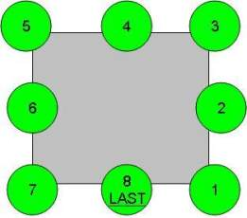
Autonomous Maintenance: How Is It Done?
Autonomous Maintenance
Time: Less than 3 Minutes
Standard work is developed to maximize efficiency
It’s made visual- and mistake-proof!
  Number each item
  Mark last item

Slide 64
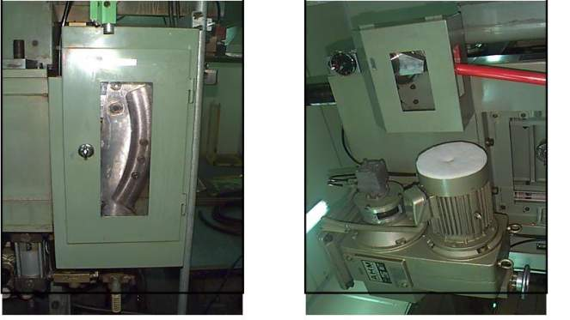
Autonomous Inspection
Autonomous Maintenance
Cut Holes in Cabinet Doors in Order to See (Inspect) Inside

Slide 65
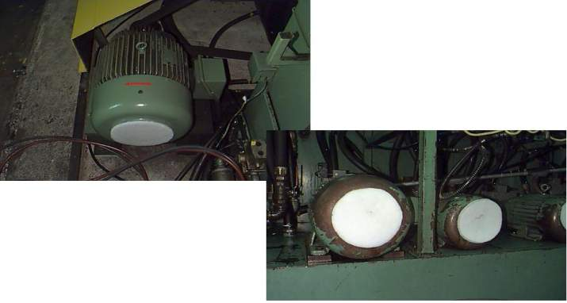
Replaceable Filters
Autonomous Maintenance

Slide 66
Exercise: Autonomous Maintenance
Autonomous Maintenance
Objective
Apply Autonomous Maintenance to the target equipment.
Instructions
Time to Complete
Using the process outlined on the previous slides, identify how many failure modes you can control through autonomous maintenance.
Answer: How long does it take to perform?
Develop standard work for the operators.
Provided by instructor
Deliverable
Autonomous maintenance opportunities identified, implemented, and standard work developed.

Slide 67
Sustain and Improve OEE
Loss Data Analysis and OEE
Restore
Deterioration
Autonomous
Maintenance
Sustain and
Improve
OEE
Maintainability
Improvement &
Maint. Avoidance
Objectives:
Define the sustain and improve OEE phase and its importance
Identify how to sustain and improve OEE
Review root cause analysis and 5 Why procedure
Identify how to take action when root causes are uncovered
Calculate equipment uptime
Create TPM visual board
Notes:
DO: Review section objectives on slide.

Slide 68
Sustain and Improve OEE: What Is It?
Sustain and Improve OEE
Adhering to a rigorous discipline greatly reducing the probability of equipment going down in an unscheduled manner, running at reduced production rate, or producing defective products
Systemically and continuously improving the effectivity
of the equipment
Every breakdown is an opportunity to improve!!!!

Slide 69
Sustain and Improve OEE: Why Do You Do It?
Sustain and Improve OEE
A process that is not improved tends to deteriorate over time
By continuously working to improve equipment uptime the plant efficiency is improved and protected from backsliding
Continuously reducing waste = improved customer service and increased profits

Slide 70
Sustain and Improve OEE: How Do You Do It?
Sustain and Improve OEE
Each event is an opportunity to improve the business
  Has the maintenance program been formally modified?
  Has the Operating procedure (Standard Work) been modified?
  Has the machine design been modified?
  If not then you are doomed to repeat history!
Corrective Maintenance
Early detection
  Autonomous maintenance
Preventive Maintenance
Predictive Maintenance
Maintenance Avoidance
Notes:
SAY: “This is where the PDCA cycle is incorporated into the maintenance process.”

Slide 71
Sustain and Continuously Improve OEE: How Do You Do It?
Sustain and Improve OEE
Root cause analysis of every failure!
  Understand what the fundamental equipment or process deficiency was and correct it on a permanent basis!
The 5 Whys
  Get to the root cause, not the symptom
  Ask why to take corrective action
  Asking why five times generally will get you to root cause
The objective is to prevent that particular failure mode from occurring again

Slide 72
Five Whys
Sustain and Improve OEE
Problem Description: __________________________________________________________________________________________
Why did the failure occur?:
Why?:
Why?:
Why?:
Why?:
Root Cause:
Corrective Action:
Is there a repetitive history of this failure? Yes / No
If yes then Plant Manager must sign off __________________________

Slide 73
Five Whys
Sustain and Improve OEE
Problem Description: Worn drive chain on table positioner
Why did the failure occur?: Sprocket was worn
Why?: Pillow block bearings holding drive shaft were worn and running out
Why?: Not adequately greased
Why?: Remote grease line broken
Why?: Banged into line during cleaning process
Root Cause: Grease line in bad position and too fragile
Corrective Action: Re-routed line and added protective armor
Is there a repetitive history of this failure? Yes / No
If yes then Plant Manager must sign off__________________________

Slide 74
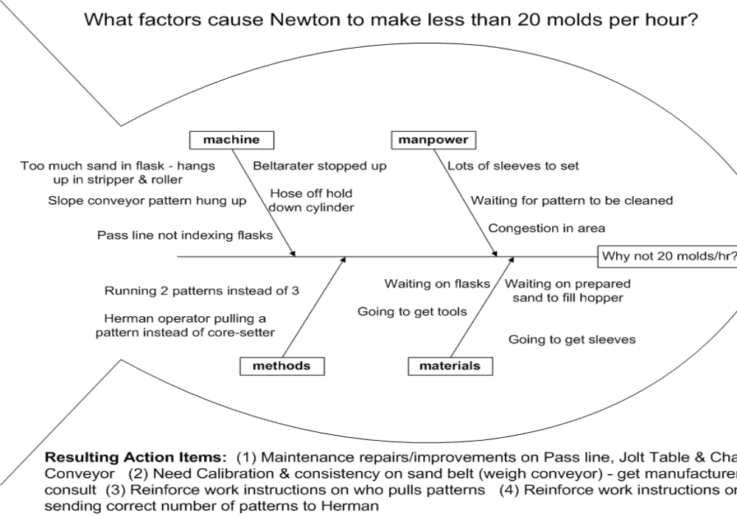
The Fishbone
Sustain and Improve OEE
Notes:
SAY: “These are simple problem solving tools even operators can use to drive to the root cause of problems. Scientific methods to fix problems.”

Slide 75
From Root Causes….
Sustain and Improve OEE
1. Identify Preventative Activities
What would lessen the deterioration or prevent breakdowns?
How can we modify the maintenance procedures?
How can we modify the operating procedures?
How can we modify the equipment design?
Notes:
ASK: What PM activities would lessen the deterioration or prevent breakdowns? Ask the group to come up with some ideas.
Examples:
Lubrication, Cleaning, Inspecting, Tightening: nuts, screws, belts?
Precision Checks of tolerances, fits, etc., Fluid Levels
What PM activities can be offloaded to operators? How would you do it so these PM activities are done correctly and on time?
Standardize with work instructions
Make a PM kit so everything is right where it is needed and the PM can happen quickly
Train the operators – teach the principles, for example, in lubrication more isn’t always better, what are the significant characteristics of the different types of oil, what are the safety issues, what should they look for what checking tension on a belt, why does it matter?
Maintenance mechanics certify operators to do the PM – certified to perform only certain tasks
Supervisor controls and limits the maintenance that is done by operators - no random acts of maintenance - have to be certified to do it
Don’t want to introduce variation - need to be able to predict what should happen, what the conditions are supposed to be, don’t want anyone making unauthorized changes without it being part of the standard procedures or settings

Slide 76
From Root Causes….
Sustain and Improve OEE
2. Make Improvements
Lessen the deterioration
Prevent breakdowns
Improve Performance
Can we change procedures so we can meet Takt Time?
Modify the documented standard work and train operators
Modify the maintenance procedure and train mechanics
Modify the equipment design and alter the equipment
Sustain the Gain!
Notes:
ASK: What improvements or equipment modifications would lessen the deterioration or prevent breakdowns? Ask the group to come up with some ideas. Some are listed here on the slide. What specific ideas would work in our situation?
**Also need a way for everyone to learn from breakdowns. Can maintenance share lessons learned with operators so operators will also know what to look for and the warning signs along the way?

Slide 77
From Root Causes….
Sustain and Improve OEE
3. Identify key process parameters that will
indicate deterioration
What would warn that this specific breakdown is near?
Vibration
Noise
Temperature
Lubrication
Changes in fluid levels
Find ways to measure and monitor (sensors)
Establish plan to address deterioration when it occurs
Notes:
ASK: What parameters should be watched to predict the deterioration or to prevent breakdowns? Ask the group to come up with some ideas. Some are listed here on the slide. What specific ideas would work in our situation?

Slide 78
Measurement
Sustain and Improve OEE
Visual indication of the effectivity of the improvement process
Show both current and trend data
Simple, Visual, Relevant

Slide 79
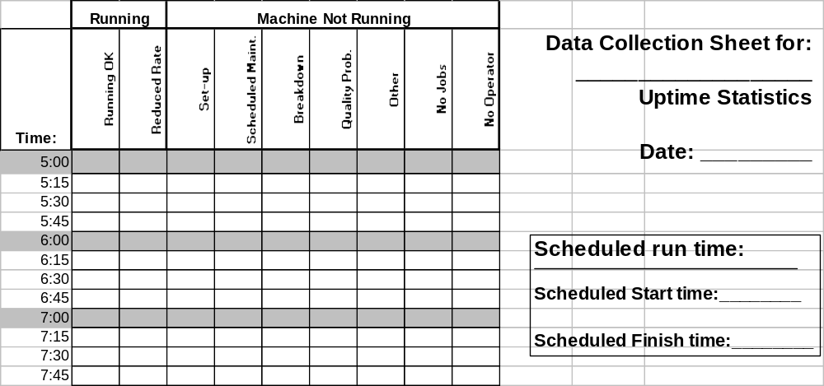
What Are Our Losses?
Sustain and Improve OEE
Can be integrated into
the “Pitch” process!
Notes:
SAY: “Can’t begin the work of problem solving and making improvements until we understand the current situation. This is data that should have been collected before the event began.”
NOTE: There is an example slide of this type of data in this PowerPoint presentation.
DO: Take the time now to go over the data you’ve collected and to discuss the causes of downtime. What percentage of the available time is the equipment actually available to run product if you need it to? This is the key question. Are these typical results for your area? What might be different now than at other times?
You can, at this time, get out the maintenance data you’ve collected (in advance of the event) and look at the reasons for downtime due to Breakdowns.

Slide 80
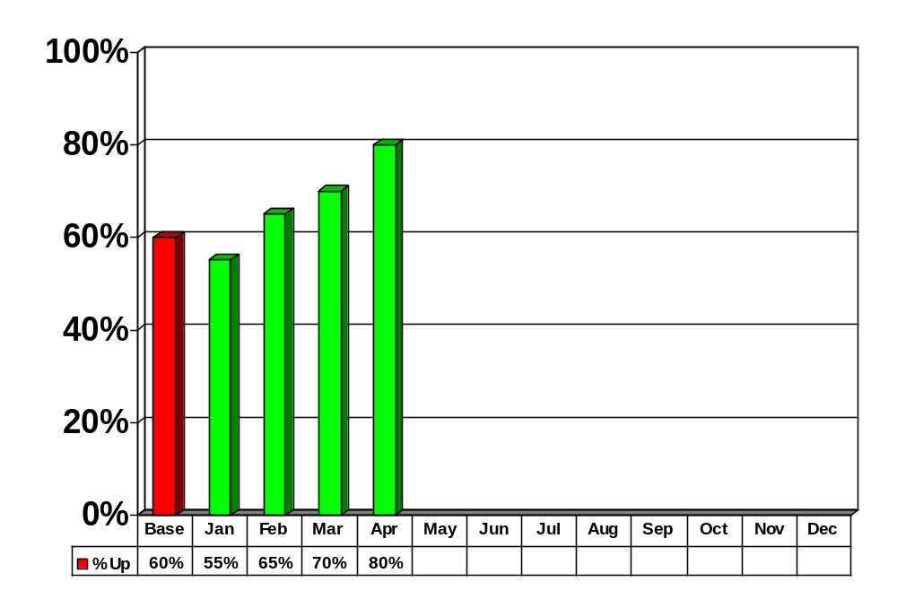
Equipment Uptime
Sustain and Improve OEE
Equip. Uptime =
Scheduled – Equipment Downtime x 100
Scheduled Time

Slide 81
TPM Visual Board
Sustain and Improve OEE
OEE Trend Data
Red Tags
Autonomous Maintenance
TPM Five Why’s History
Open Action Items
Pitch Charts
Notes:
SAY: “TPM visual board enables Team Leaders, Supervisors, Management, to quickly see the status on equipment. Visual verification if scheduled checks are being done, downtime problems are being solved, and action items are being addressed.”

Slide 82
Exercise: OEE Sustaining and Continuous Improvement
Sustain and Improve OEE
Objective
Apply OEE Sustain and Continuous Improvement concepts to target equipment.
Instructions
Time to Complete
Answer: How would the loss data analysis have been improved if done immediately after the breakdown?
20 minutes
Deliverable
Answer question.

Slide 83
Improve Maintainability and Maintenance Avoidance
Loss Data Analysis and OEE
Restore
Deterioration
Autonomous
Maintenance
Sustain and
Improve
OEE
Maintainability
Improvement &
Maint. Avoidance
Objectives:
Define “Improve Maintainability” and identify its importance
Identify how to improve maintainability
Review visual management examples
Define “Maintenance Avoidance” and identify its importance
Identify how to apply maintenance avoidance concepts
Notes:
DO: Review section objectives on slide.

Slide 84
Improve Maintainability: What Is It?
Maintainability Improvement & Maint. Avoidance
We use the tools of Standard Work, Poka Yoke, Visual Management, for the manufacturing process…
  Why not the maintenance process?
Requires modification of equipment design
Requires modification of tooling
Requires modification of maintenance procedure
Notes:
SAY: “TPM is no different from the other Lean tools, change for the better. Changes and modifications will be necessary to procedure, tooling, equipment as problem solving solutions are determined.”

Slide 85
Improve Maintainability: Why Do It?
Maintainability Improvement & Maint. Avoidance
Better utilize scarce resources in maintenance
Improve the quality of the maintenance performed
Increase the probability of it being done on schedule
Further reinforce the Lean way of management
Notes:
SAY: “Maintenance resources are a premium. These resources should be used to solve technical, root cause solutions.”

Slide 86
Improve Maintainability: How Do You Do It?
Maintainability Improvement & Maint. Avoidance
Pareto maintenance procedures based on cycle time and frequency
Observe and video tape repetitive maintenance procedures
  Record each step, the time it takes, and look for ways of improving
  Quick fasteners
  Easier access
  Relocation of components
  Externalize operations
Create Standard Work for PM

Slide 87
Improve Maintainability: Visual Management of Spares Room
Maintainability Improvement & Maint. Avoidance
Using shaft targets as a reminder to rotate motor and fan shafts while in storage to prevent "false brinelling" of bearings and armature sag due to lack of rotation
Inventory control cards with photograph of parts, part numbers, lead time for re-ordering, supplier or source, minimum/maximum levels
Reorder signal cards placed at the minimum inventory level

Slide 88
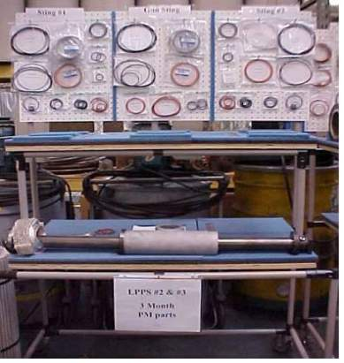
Maintainability Improvement & Maint. Avoidance

Slide 89
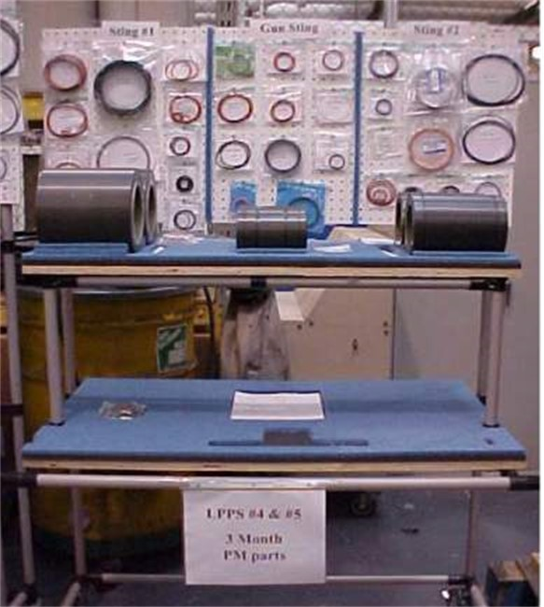
Maintainability Improvement & Maint. Avoidance

Slide 90
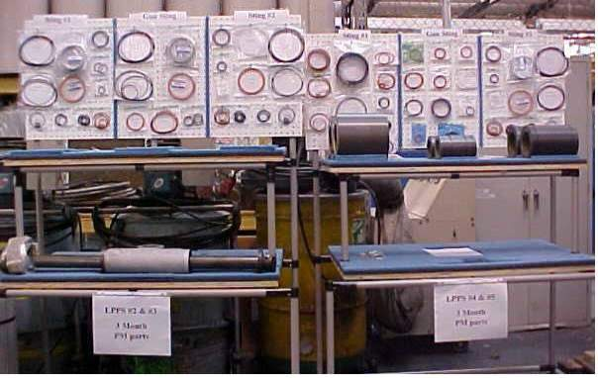
LPPS Coater 3 Month PM Carts
Maintainability Improvement & Maint. Avoidance

Slide 91
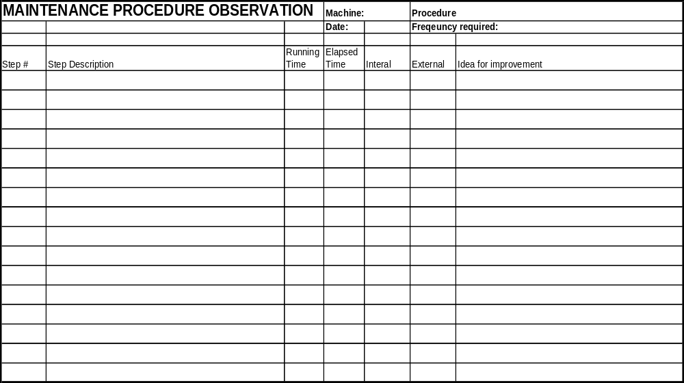
Maintainability Improvement & Maint. Avoidance

Slide 92
Exercise: Maintenance Improvement
Maintainability Improvement & Maint. Avoidance
Objective
Apply Maintenance Improvement Concepts.
Instructions
Time to Complete
In small groups, consider and discuss common maintenance procedures performed routinely.
By applying the Maintenance Improvement concepts outlined on the previous slides, how much time can you remove from the most common maintenance procedure?
15 minutes
Deliverable
Brainstorm, jotting down ideas. Report answers to class.

Slide 93
Maintenance Avoidance: What Is It?
Maintainability Improvement & Maint. Avoidance
Analyzing the equipment design for opportunities to eliminate or reduce the need for a specific maintenance procedure
The best maintenance is no required maintenance!!

Slide 94
Maintenance Avoidance: Why Do It?
Maintainability Improvement & Maint. Avoidance
Improve quality by eliminating the deteriorate and restore cycle
Improve productivity of maintenance personnel

Slide 95
Maintenance Avoidance: How Do You Do It?
Maintainability Improvement & Maint. Avoidance
Pareto maintenance procedures based on cycle time and frequency
Focus on top hitters to redesign equipment
  Self lubricating bearings
  Larger filters
  Skimmers
  Etc…
Notes:
SAY: “Use problem solving techniques previously discussed to come to conclusions. Ask the 5-why’s, fishbone diagram…”

Slide 96
Exercise: Maintenance Avoidance
Maintainability Improvement & Maint. Avoidance
Objective
Apply Maintenance Avoidance concepts.
Instructions
Time to Complete
In small groups, consider and discuss common maintenance procedures.
Can you eliminate a maintenance procedure, or extend its interval, by altering the equipment?
15 minutes
Deliverable
Brainstorm, jotting down ideas. Report answers to class.

Slide 97
Running the Event

Slide 98
Event Goals
Three minutes to conduct autonomous maintenance procedure!
25% reduction in the time required to perform routine maintenance!
Address root causes for most significant failure modes!
Implement a process of sustaining continuous improvement of equipment effectivity beyond the end of the event!

Slide 99
Lets Get Started! TPM Team Checklist
Monday - Tuesday Analysis
  The team should introduce themselves to the operators running the target machinery on all shifts. Explain the objective of the event and ask for their participation on an as-needed basis. Share the down time information with them and ask for confirmation that this is in line with their experiences, especially minor stoppages.
  The team should gather and review as much data as possible on historical breakdowns, minor stoppages, compromised operations, quality output, and maintenance hours spent.
  Complete the Loss Data Analysis sheet and modify “The Big Three” based on “Five Whys”
  Complete current state OEE calculation

Slide 100
Lets Get Started! TPM Team Checklist
Monday - Tuesday Analysis (continued)
  Each person should investigate the equipment and fill out a 5S score sheet. Regroup and agree on what the score should be and designate one of the charts and assessment sheets the masters for the team. The Team Captain should keep a folder for all masters. If a team member needs the form a copy should be made so that masters are kept clean, are not lost, and represent the teams’ latest information.
  Start the “Clean to Detect” phase and record each and every machine deficiency observed on a “Red Tag List.” TPM begins and ends with 5S. A Simplify, Straighten, and Scrub activity should be conducted immediately
  Report on findings

Slide 101
Lets Get Started! TPM Team Checklist
End of Day Tuesday Restoration
  During the equipment cleaning process the machine should be thoroughly inspected for any deficiencies and these should be tagged and listed on the “Red Tag List”
  The team should brainstorm ideas for 5S improvements that can be done as a prelude to the TPM activity
  Report on Red Tags identified to this point and the 5S plan for the week
Mid-day Wednesday Sustain & Improve
  Develop and practice Autonomous Maintenance
  Practice Five Whys Analysis with Maintenance
  Report on Autonomous Maintenance and Red Tag Status

Slide 102
Lets Get Started! TPM Team Checklist
End of day Wednesday Improve Maintainability
  Complete cleaning and painting
  Post all labels and visual management tools
  Select and observe a repetitive maintenance procedure and observe it
  Report on Maintenance observation status
Mid-day Thursday Improve Maintainability
  Complete the Maintenance Observation Form
  Report on waste reduction on observed maintenance procedure

Slide 103
Lets Get Started! TPM Team Checklist
End of Day Thursday Continuous Improvement of OEE
  Review Operating Procedures, PM Procedures, and Equipment Design for necessary changes and make documented improvements based on 5 Whys analysis
  Complete all visuals
  Complete Open action items documentation
  Report on Red Tag status, Autonomous Maintenance, Maintenance Improvement
Friday
  Prepare for closeout presentation
  Practice 15 minute presentation
  Close out session

Slide 104
Recommended Further Reading
The New Manufacturing Challenge, Kiyoshi Suzaki
TPM for Every Operator, Productivity Press
TPM Team Guide, Productivity Press
Introduction to TPM, Seiichi Nakajima, Productivity Press
The Visual Factory, Michael Greif
TPM for Workshop Leaders, Kunio Shirose, Productivity Press
TPM Program Development, Seiichi Nakajima, Productivity Press

Slide 105
Other Modules In This Series:
5S
Standard Work
Total Productive Maintenance (TPM)
Administrative Lean
Cell Design/ Production Preparation Process (3P)
Kaizen
Kanban
Problem Solving
Poka Yoke Quality Systems
Transaction Process Improvement (TPI)
Cause & Effect Diagram with the Additions of Cards (CEDAC)
Single Minute Exchange of Dies (SMED)
Value Stream Mapping (VSMi®)
Visual Management
Managing Daily Process Excellence
For More Information Please Contact:
Mark DeLuzio, President and CEO
+1.860.234.0915
mark.deluzio@leanhorizons.com
Strategically Creating Value Through the Elimination of Waste

